Slide 1

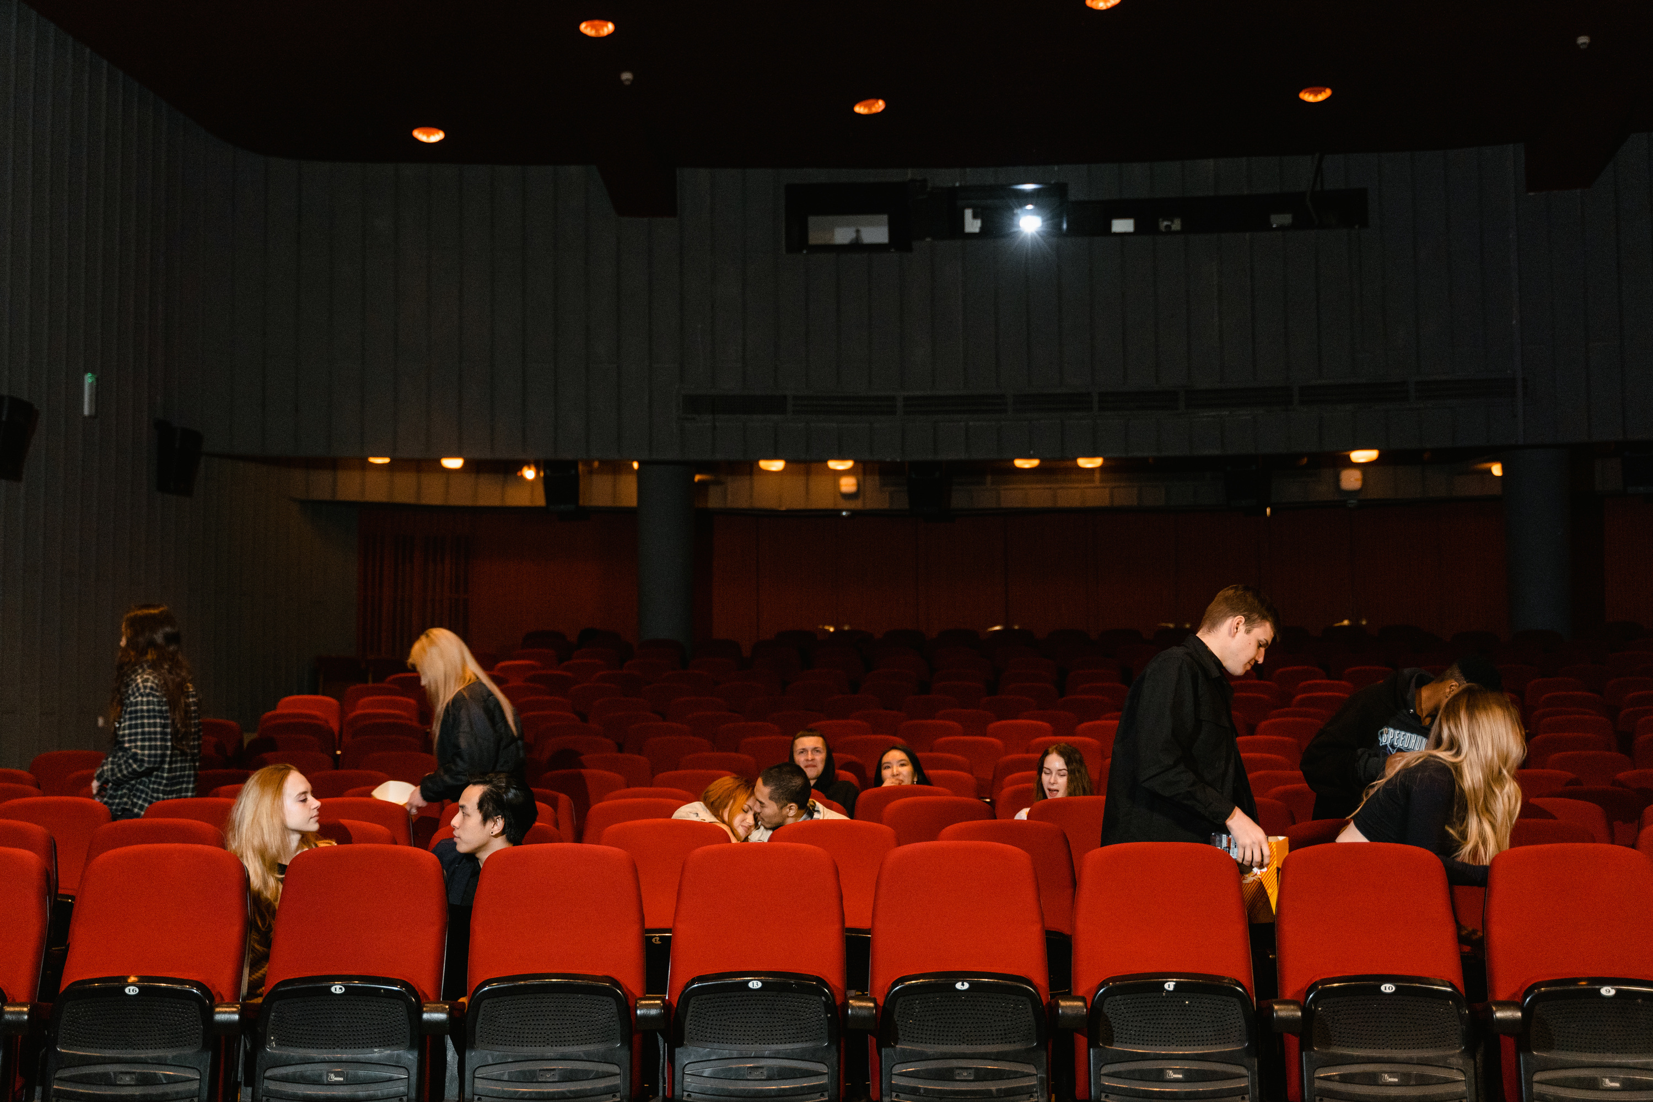
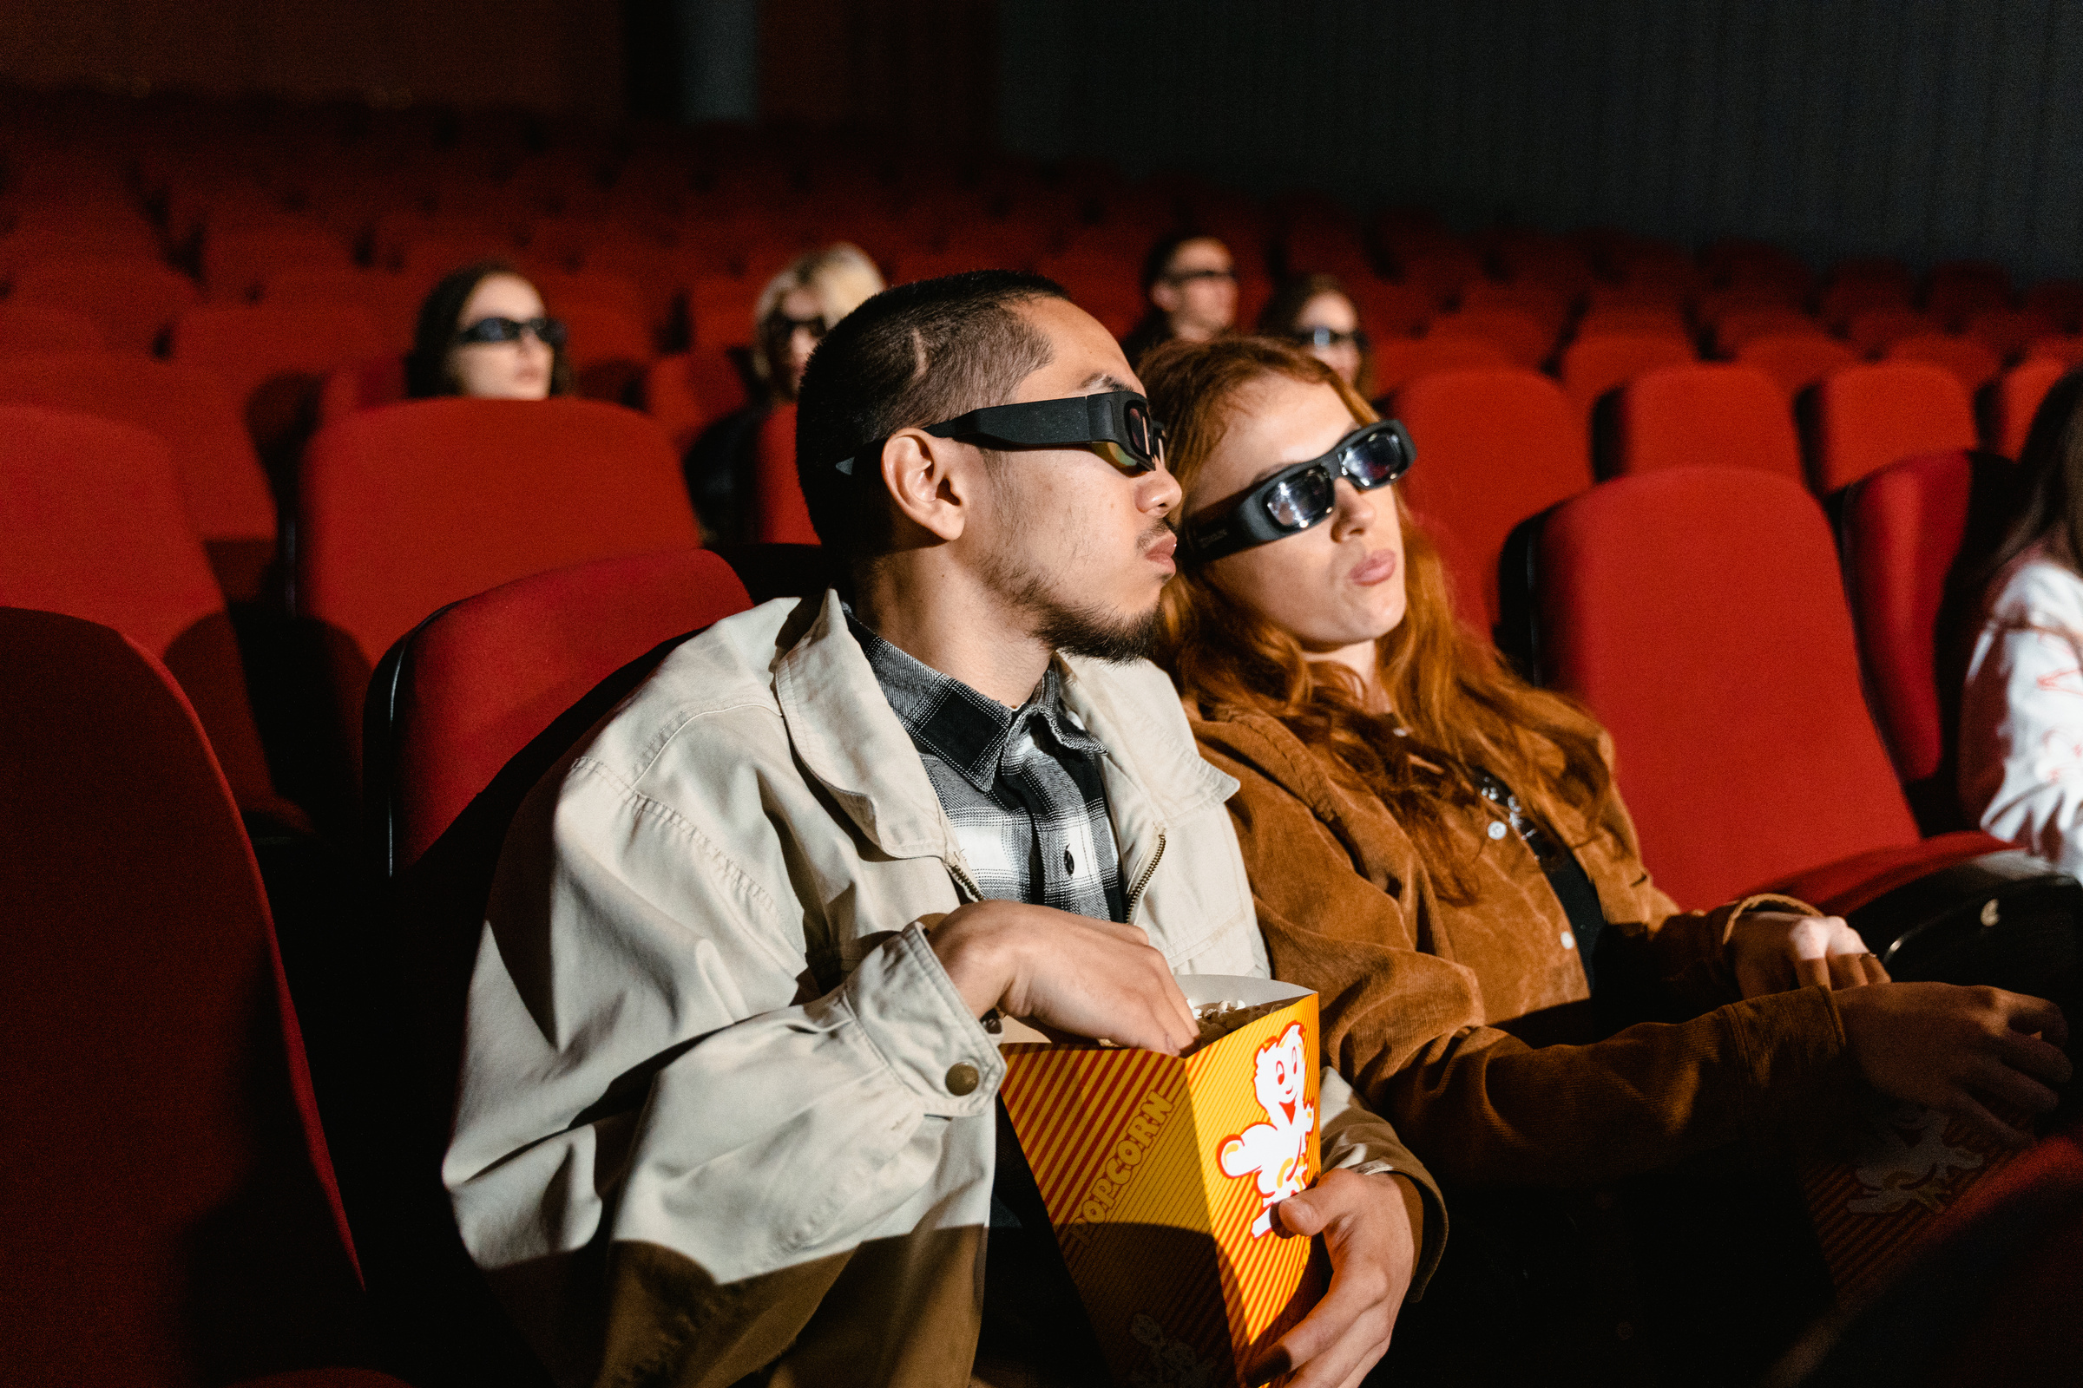
ONLINE MOVIE TICKET BOOKING APP
The goal of the project is to implement an application for booking movie tickets online. The ticket booking application is an internet-based application, which means that the application can be accessed from anywhere on the network. This online ticket reservation system provides a cinema website that is accessible to all internet users.
Submitted by:-
2310030045: T. Sai Uday
2310030035: P. Shanmukha Srinivas
2310030450: A. Rahul
2310030307: K. Charan
2310030096: T. Akhil Raj

Slide 2
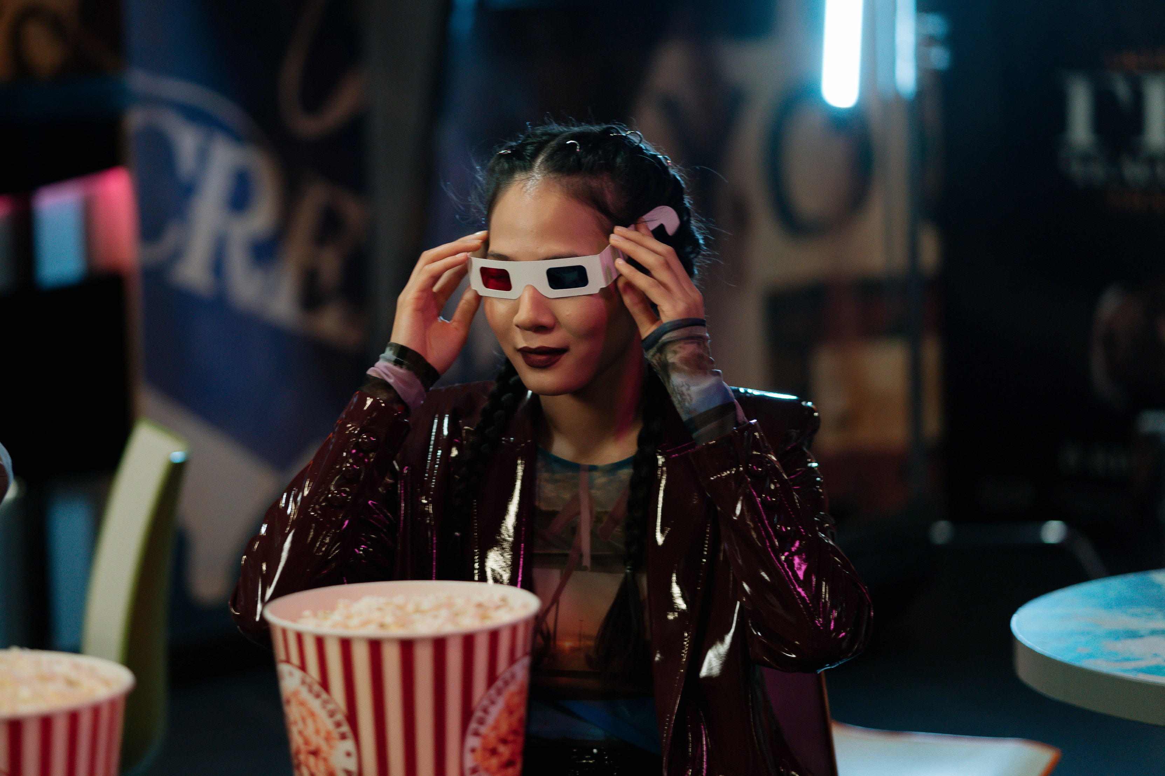
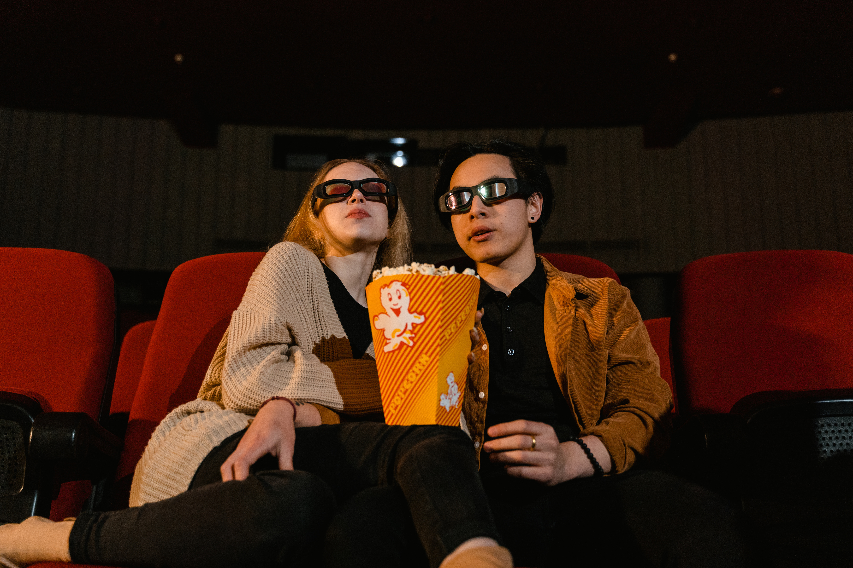
CLARITY OF PROJECT TITLE
TITLE JUSTIFICATION
The title clearly communicates the purpose and domain of the project.
The phrase "Movie Ticket Booking" specifies the core functionality.
The use of "React" in the title clearly states the technology used in the front-end.
It is simple, understandable, and direct – making it easy for anyone to grasp the objective.

Slide 3
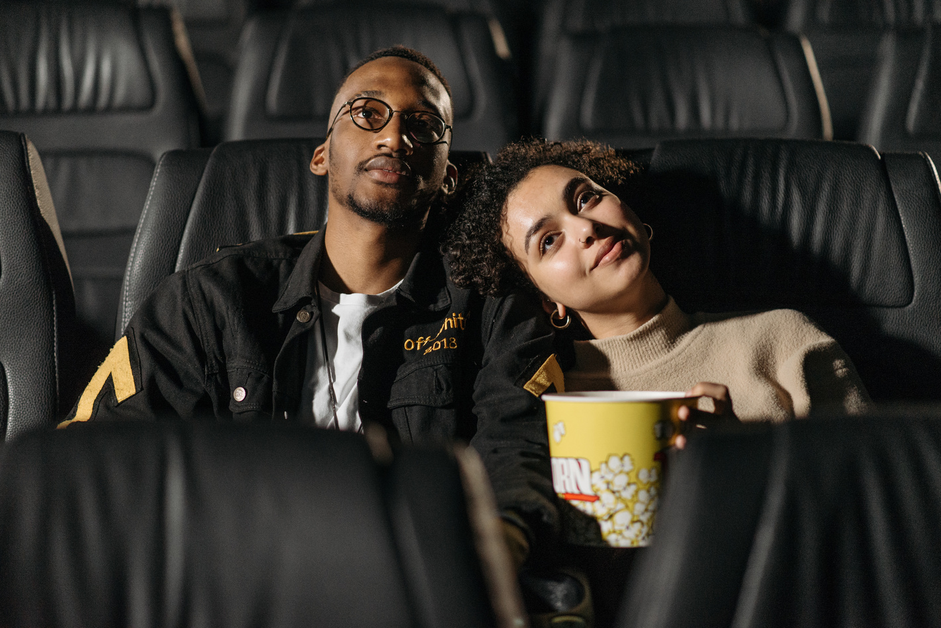

PROJECT FEASIBILITY ANALYSIS
The project is technically feasible as it is developed using React, a popular JavaScript library known for its reusable components, and integrates easily with APIs like TMDB for movie data and payment gateways such as Stripe or Razorpay. The responsive user interface is designed using Tailwind CSS, ensuring compatibility across devices.
TECHNICAL FEASIBILITY:
DEVELOPED USING REACT – A POPULAR JAVASCRIPT LIBRARY WITH REUSABLE COMPONENTS.
RESPONSIVE UI CAN BE CREATED USING TAILWIND CSS.

Slide 4
OPERATIONAL FEASIBILITY:
EASY TO USE AND NAVIGATE INTERFACE.
PROVIDES A DIGITAL SOLUTION FOR A COMMONLY NEEDED TASK – BOOKING MOVIE TICKETS.
ECONOMIC FEASIBILITY:
LOW DEVELOPMENT COST: USES FREE/OPEN-SOURCE TOOLS.
HOSTED VIA SERVICES LIKE VERCEL OR NETLIFY (FREE TIERS AVAILABLE).

Slide 5
ORIENTED WITH SOCIETAL NEEDS
PROBLEM IN SOCIETY:
SOLUTION THROUGH THIS APP:
IMPACT:
People waste time in long queues at theaters.
Lack of real-time seat availability.
Limited accessibility to remote or less-known cinema websites.
Enables users to book tickets from their phone/laptop at any time.
Supports secure online payments.
Shows real-time seat availability and showtimes.
Enhances the movie-going experience.
Reduces crowding at theaters.
Promotes digital adoption in entertainment services.

Slide 6
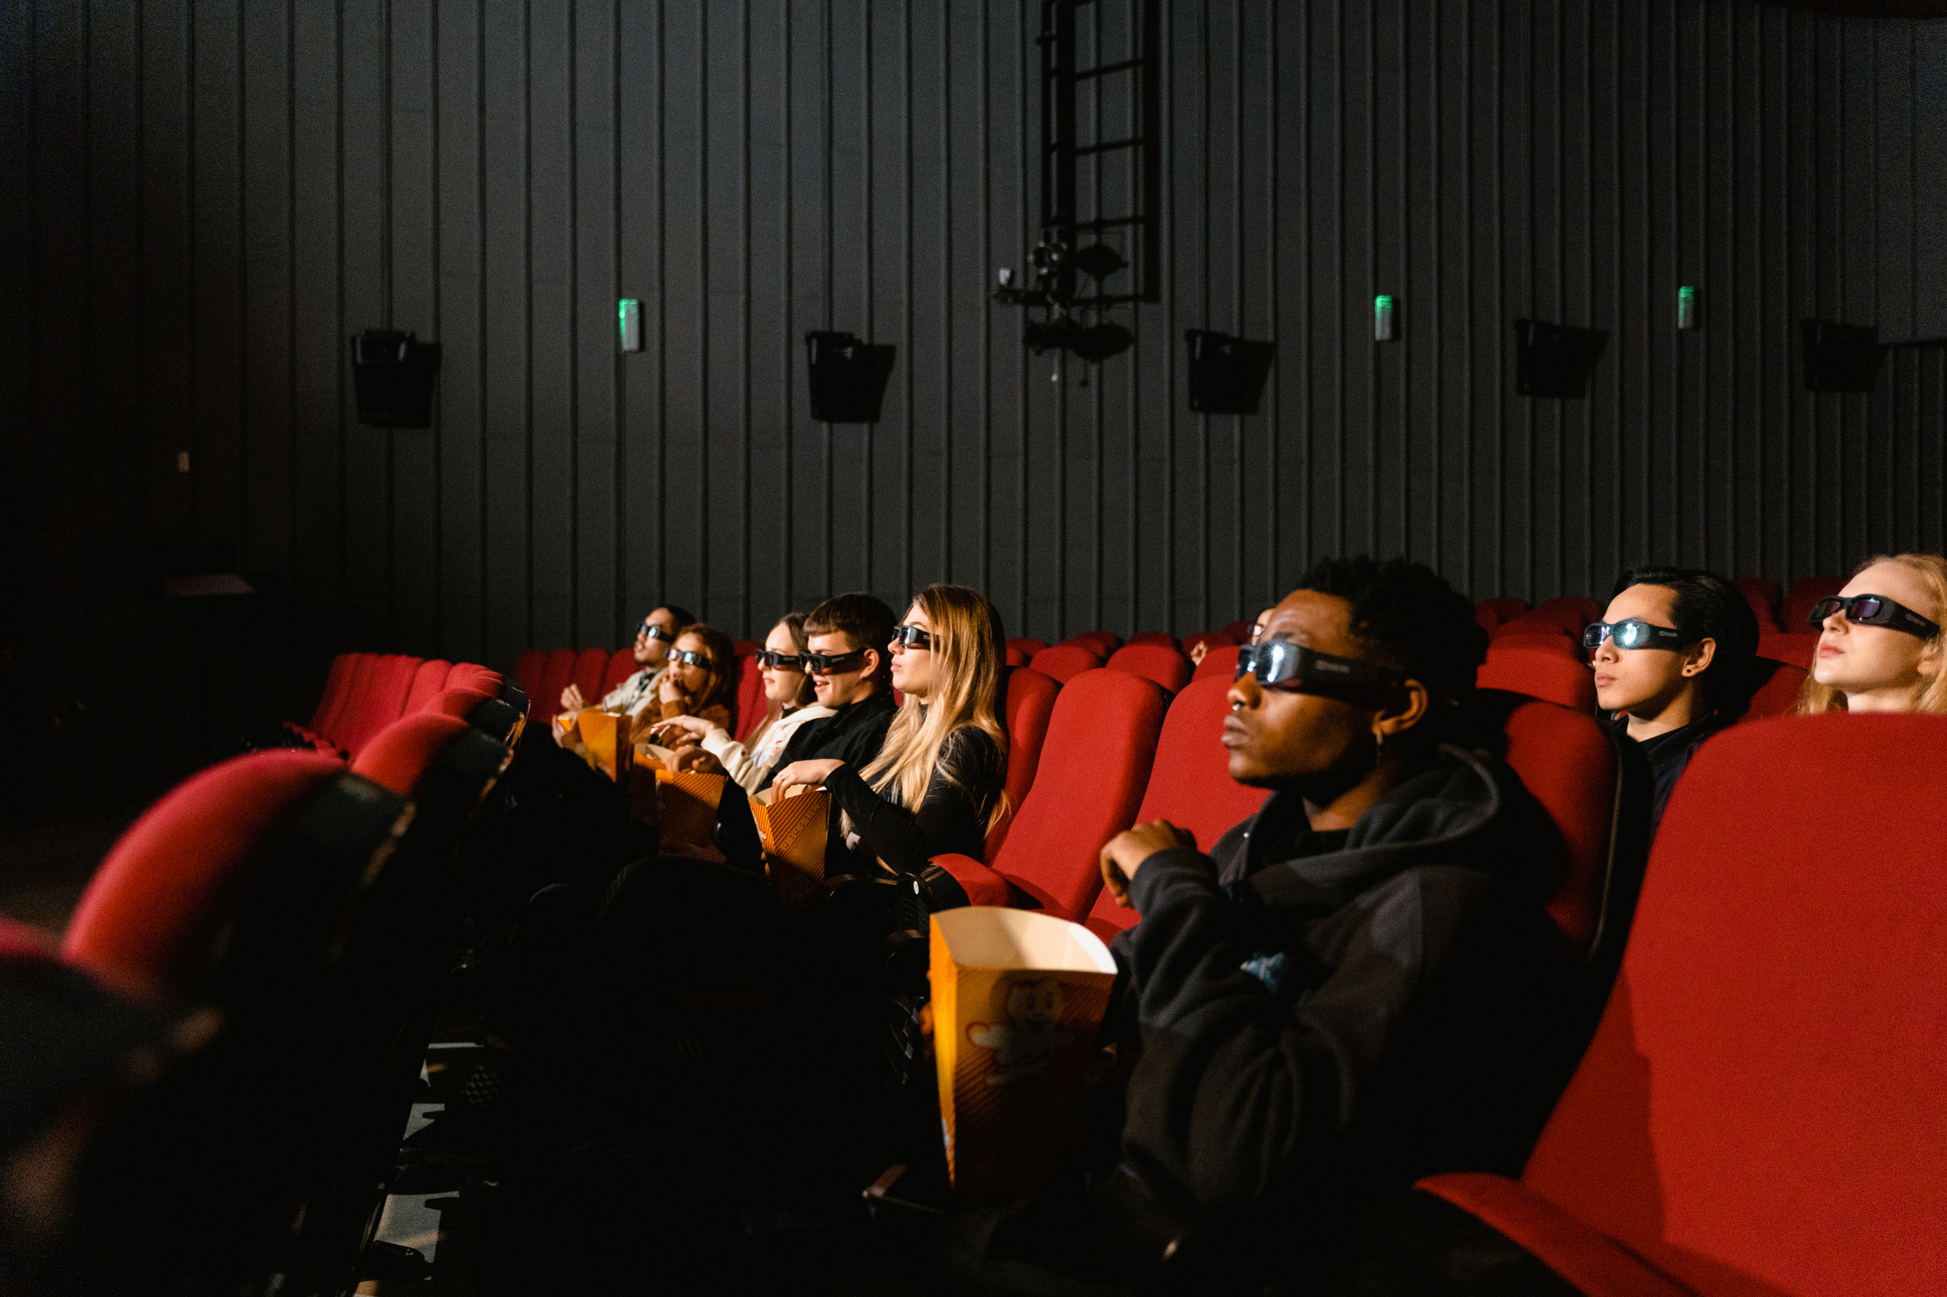
APP FLOW / ARCHITECTURE
User Journey:
User logs in/signs up.
Browses movies by date, language, or genre.
Selects showtime and seats.
Confirms and pays for the ticket.
Receives a digital ticket via email or in-app.

Slide 7
Tech Stack:
Frontend: React.js
Styling: Tailwind CSS
Backend (Optional): Firebase or Node.js + Express
Database: Firestore or MongoDB (for storing bookings/user data)
APIs: TMDB (The Movie Database) API for movie info, Razorpay/Stripe for payments

Slide 8
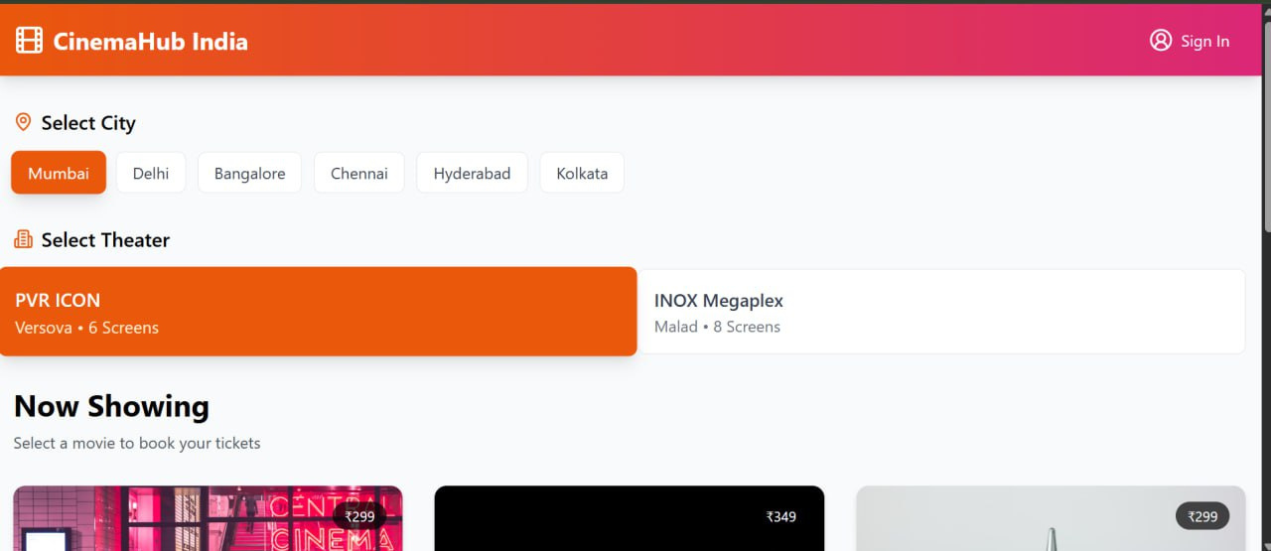
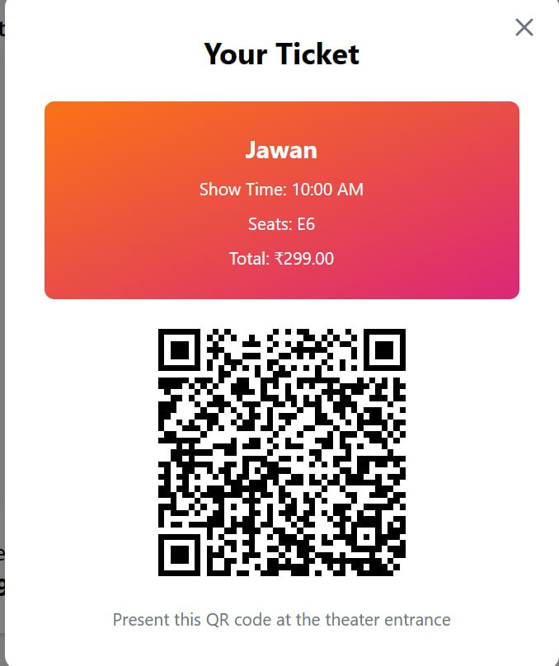
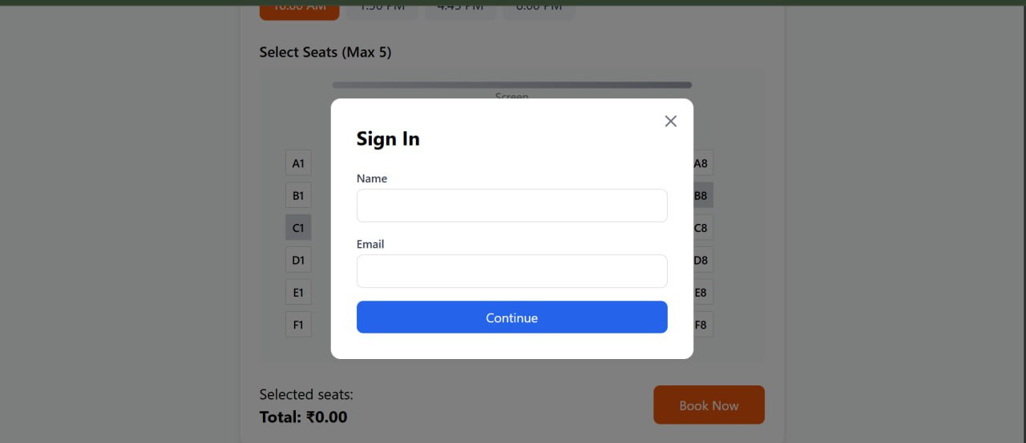
Screenshots of our Project

Slide 9
FUTURE SCOPE
SCALABLE FEATURES TO ADD:
Food & beverage pre-ordering
Loyalty points and discount coupons
AI-powered movie suggestions
Multilingual support for diverse regions
Partnering with local cinemas for live inventory

Slide 10
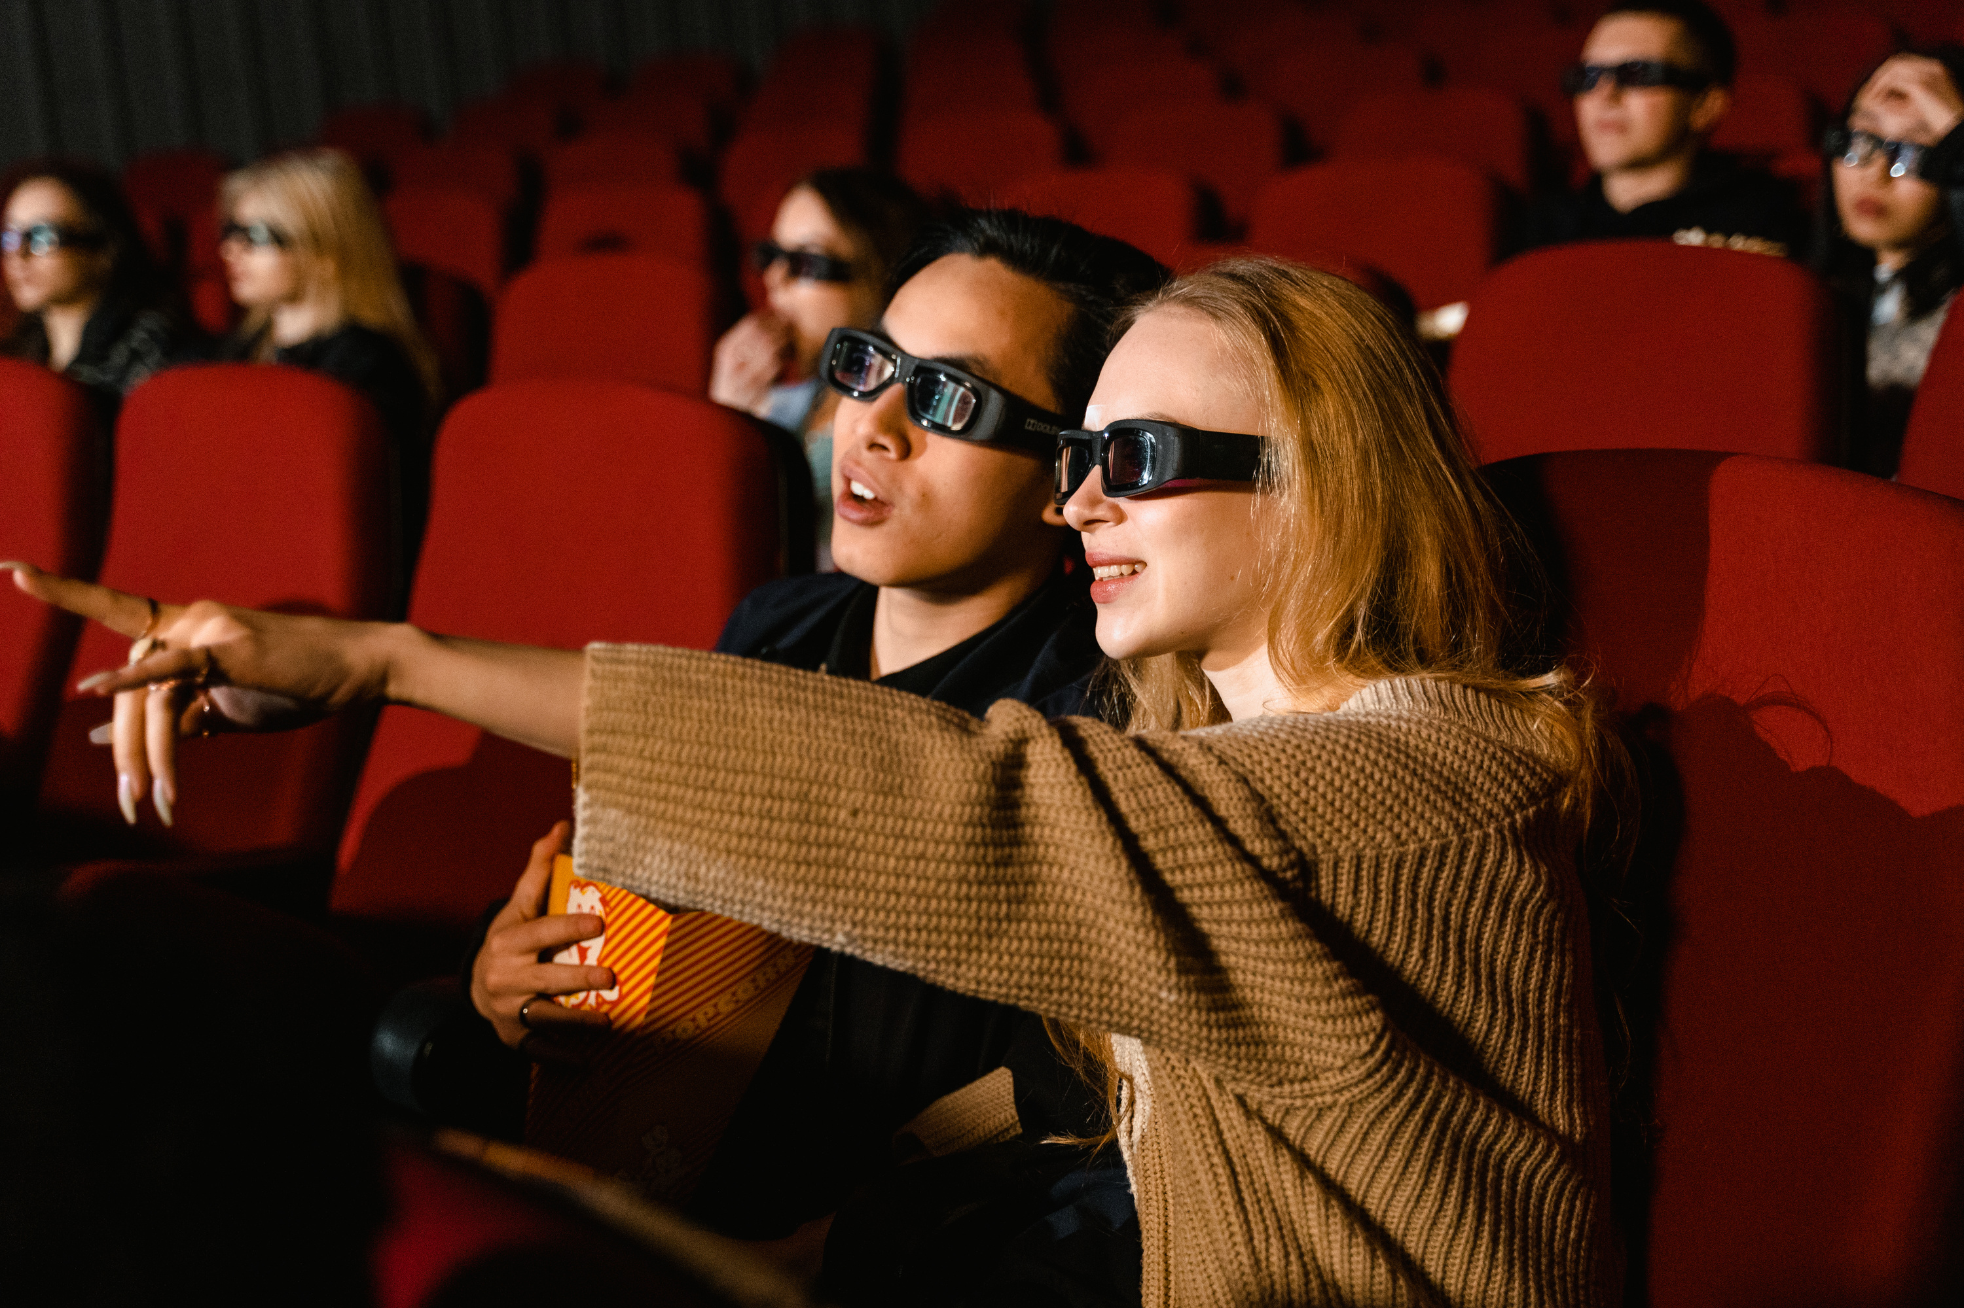
CONCLUSION
The Movie Ticket Booking App using React provides a modern, efficient, and user-friendly solution for booking movie tickets online. By leveraging powerful tools like React and integrating dynamic APIs, the app not only simplifies the booking process but also addresses real-world societal needs for convenience and digital access.
With its scalable architecture, intuitive design, and scope for future enhancements, this project demonstrates both technical feasibility and practical impact. It has the potential to be transformed into a fully functional product that can benefit moviegoers and cinema operators alike.

Slide 11
THANK YOU
SEE YOU NEXT TIME

